Slide 1
Figure 1. Obtaining a probe-probe distance distribution from X-ray scattering interferometry. (Left) A DNA duplex is labeled with gold nanocrystal probes. Subtracting the scattering profiles of the two singly labeled helices from the profiles of the doubly lab...
Xuesong Shi, Steve Bonilla, Daniel Herschlag, Pehr Harbury
Chapter Three – Quantifying Nucleic Acid Ensembles with X-ray Scattering Interferometry
Methods in Enzymology, Volume 558, 2015, 75–97
http://dx.doi.org/10.1016/bs.mie.2015.02.001

Slide 2
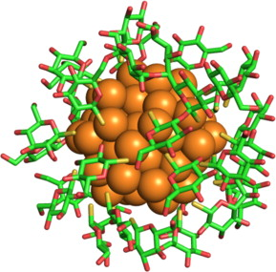
Figure 2. An illustration of the Au nanocrystal (spheres) with its thioglucose protection shell. The nanocrystal coordinates are based on a substructure of the nanocrystal reported in Jadzinsky, Calero, Ackerson, Bushnell, and Kornberg (2007) and the experimen...
Xuesong Shi, Steve Bonilla, Daniel Herschlag, Pehr Harbury
Chapter Three – Quantifying Nucleic Acid Ensembles with X-ray Scattering Interferometry
Methods in Enzymology, Volume 558, 2015, 75–97
http://dx.doi.org/10.1016/bs.mie.2015.02.001

Slide 3
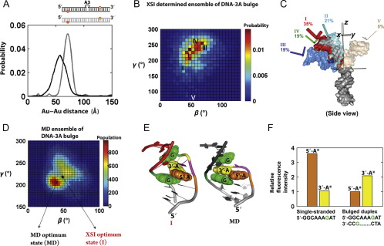
Figure 3. An ensemble model for a three adenosine DNA (DNA-3A) bulge based on XSI data. (A) Comparison of the Au–Au center-to-center distance distributions for a 26-base pair DNA helix (gray) and for DNA-3A, a 26-base pair DNA helix with a three adenosine bulg...
Xuesong Shi, Steve Bonilla, Daniel Herschlag, Pehr Harbury
Chapter Three – Quantifying Nucleic Acid Ensembles with X-ray Scattering Interferometry
Methods in Enzymology, Volume 558, 2015, 75–97
http://dx.doi.org/10.1016/bs.mie.2015.02.001

Slide 4
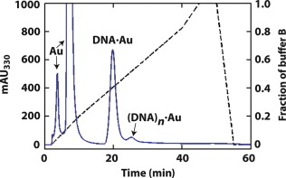
Scheme 1. Two sets of hypothetical 15-mer DNA constructs. The top quartet is labeled with gold nanocrystal probes at its ends, and the bottom quartet is labeled with gold nanocrystals at internal thymidine residues. The quartets are assembled from four single-...
Xuesong Shi, Steve Bonilla, Daniel Herschlag, Pehr Harbury
Chapter Three – Quantifying Nucleic Acid Ensembles with X-ray Scattering Interferometry
Methods in Enzymology, Volume 558, 2015, 75–97
http://dx.doi.org/10.1016/bs.mie.2015.02.001

Slide 5
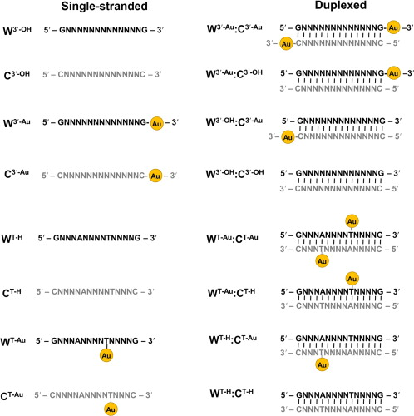
Figure 4. A sample HPLC chromatogram of Au-labeled oligonucleotides. An ion-exchange HPLC chromatogram of a crude coupling reaction between gold nanocrystals and thiol-modified DNA. The different products and biproducts include uncoupled gold nanocrystals (Au)...
Xuesong Shi, Steve Bonilla, Daniel Herschlag, Pehr Harbury
Chapter Three – Quantifying Nucleic Acid Ensembles with X-ray Scattering Interferometry
Methods in Enzymology, Volume 558, 2015, 75–97
http://dx.doi.org/10.1016/bs.mie.2015.02.001

