Slide 1
Three αSNAP and 10 ATP Molecules Are Used in SNARE Complex Disassembly by N-ethylmaleimide-sensitive Factor (NSF)*
Niket Shah, Karen N. Colbert, Michael D. Enos, Daniel Herschlag, William I. Weis
Journal of Biological Chemistry
Volume 290 Issue 4 Pages 2175-2188 (January 2015)
DOI: 10.1074/jbc.M114.620849
Copyright © 2015 © 2015 ASBMB. Currently published by Elsevier Inc; originally published by American Society for Biochemistry and Molecular Biology. Terms and Conditions

Slide 2
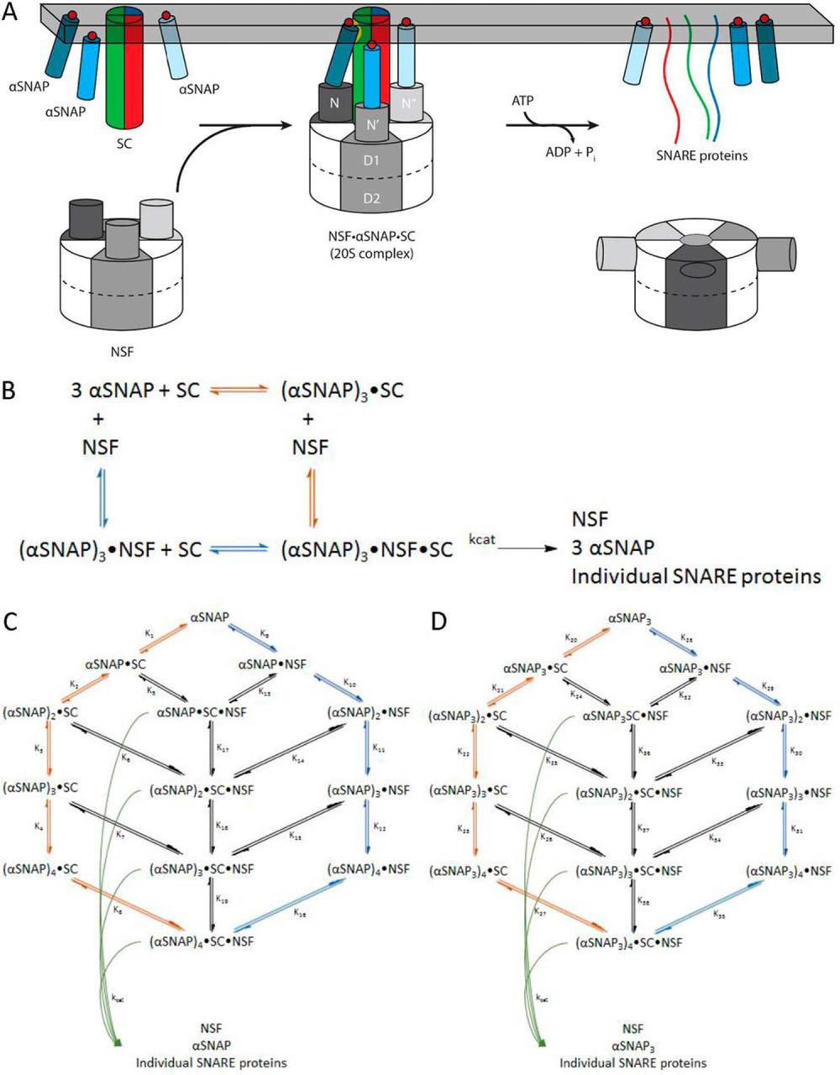
FIGURE 1
Journal of Biological Chemistry 2015 2902175-2188DOI: (10.1074/jbc.M114.620849)
Copyright © 2015 © 2015 ASBMB. Currently published by Elsevier Inc; originally published by American Society for Biochemistry and Molecular Biology. Terms and Conditions
Notes:
NSF uses the energy of ATP hydrolysis and the αSNAP adaptor to disassemble the SNARE complex. A, NSF binds to the membrane-bound SC via αSNAP, which is probably membrane-associated. Using the energy from ATP hydrolysis, the SC is disassembled into its component proteins, and NSF and αSNAP are available for subsequent rounds of disassembly. B, simplified model for the dissociation of the SC by NSF bound to 3 αSNAP, in which either αSNAP binds SC before NSF (red pathway) or SC binds to αSNAP·NSF to form the 20 S complex (blue pathway in B and C). C, kinetic modeling scheme for the association of n αSNAP molecules with SC and disassembly of the SC by NSF. The red branch represents binding of n αSNAP molecules to the SC to form the complete NSF substrate before interaction with NSF; the blue branch corresponds to n αSNAP molecules binding to NSF before association with the SC. Potential intermediate, non-productive assemblies lacking sufficient αSNAP molecules to support SC disassembly are also shown. For a given model that uses n αSNAP molecules, the 20 S complex will be (αSNAP)n·SC·NSF, which disassembles into n αSNAPs, the individual SNARE proteins, and free NSF (curved green arrows). D, kinetic modeling scheme for the association of n αSNAP3 molecules with SC and disassembly of the SC by NSF. The red branch represents binding of n αSNAP3 molecules to the SC to form the complete NSF substrate before interaction with NSF; the blue branch corresponds to n αSNAP3 molecules binding to NSF before association with the SC. Potential intermediate, non-productive assemblies lacking sufficient αSNAP3 molecules to support SC disassembly are also shown. For a given model that uses n αSNAP3 molecules, the 20 S complex will be (αSNAP3)n·SC·NSF, which disassembles into n αSNAP3s, the individual SNARE proteins, and free NSF (curved green arrows).

Slide 3
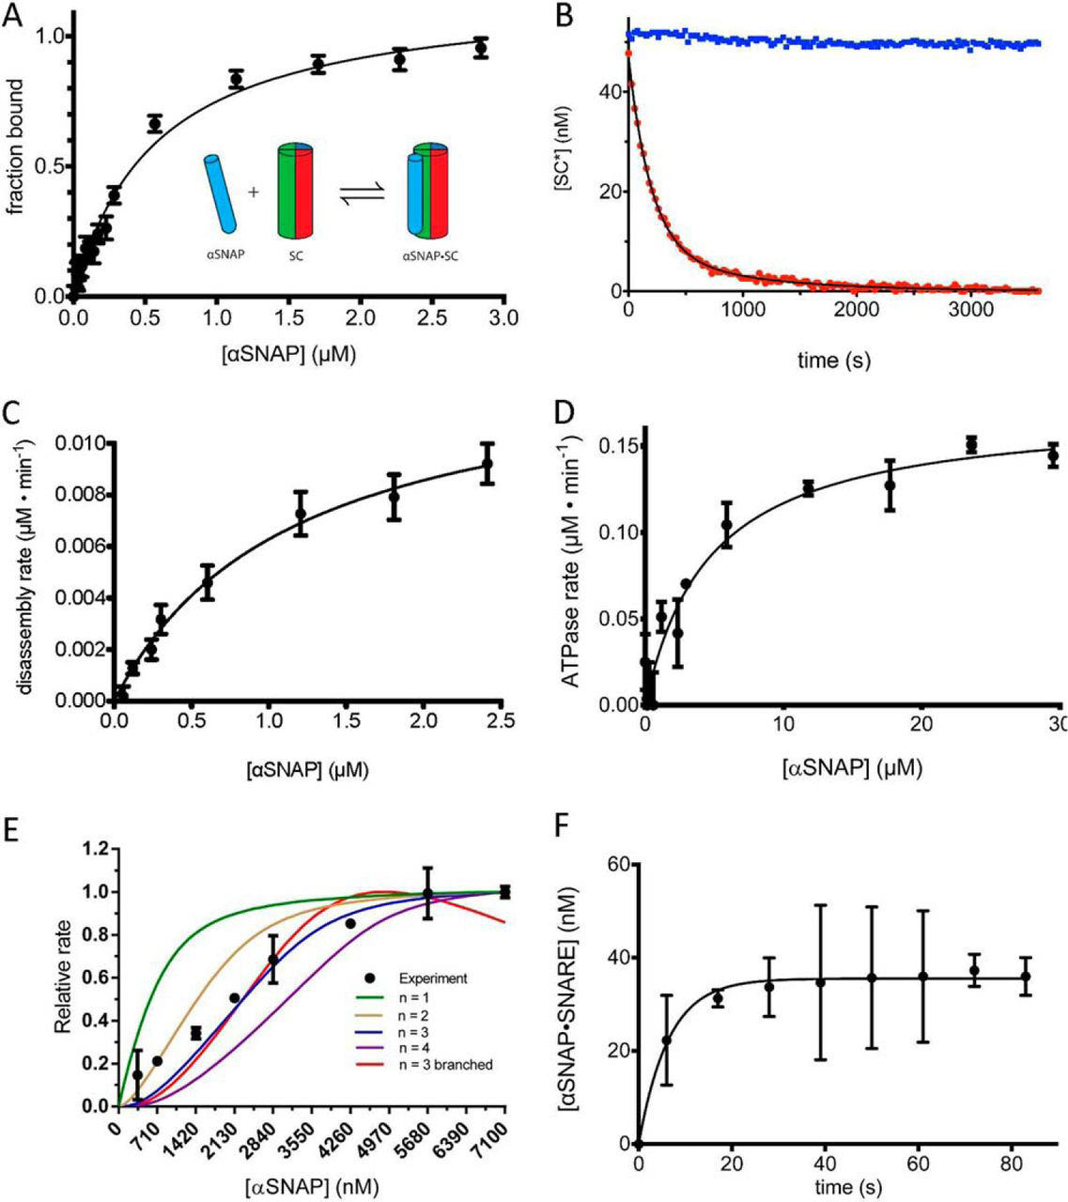
FIGURE 2
Journal of Biological Chemistry 2015 2902175-2188DOI: (10.1074/jbc.M114.620849)
Copyright © 2015 © 2015 ASBMB. Currently published by Elsevier Inc; originally published by American Society for Biochemistry and Molecular Biology. Terms and Conditions
Notes:
The role of αSNAP in binding and disassembling the SNARE complex. A, SC containing labeled VAMP2-A488 (50 nm) was combined with increasing concentrations of αSNAP (0–3 μm), and the change in fluorescence anisotropy was measured. The data are shown fit to a single-site binding curve giving Kd^{αSNAP·SNARE}d = 450 ± 52 nm. The inset schematic shows a single αSNAP interaction with the SC. B, representative disassembly assay. Alexa Fluor 488-labeled SC (SC*) (50 nm) was combined with excess αSNAP (4 μm) and disassembled by NSF (2 nm) in the presence of ATP (1 mm) and Mg²⁺ (5 mm) (red). A control experiment was performed in the absence of Mg²⁺ (blue). C, initial rates of SC disassembly in steady-state conditions were measured with increasing concentrations of αSNAP (0–2500 nm). The data are fit to the equation, v = Vmax/(1 + Km/αSNAP) to give the maximal rate kcat and Km^{αSNAP} for SC (solid black line) (Table 2). D, the ATPase activity of NSF as a function of αSNAP concentration. The data are fit to the equation, ν = Vmax/(1 + (Km/[αSNAP])) (solid black line) to give the Km^{αSNAP} for NSF ATPase activity. E, SC disassembly rates (y axis) were measured with SC and NSF at high, fixed concentrations (1 μm each) with a range of αSNAP concentrations (0.4–7.1 μm). The lines correspond to models with different αSNAP stoichiometry, as indicated in the key. Descriptions of the models can be found under “Experimental Procedures.” F, association of αSNAP (2 μm) with SC (50 nm) as measured by fluorescence anisotropy. A 6-s instrument dead time was accounted for by shifting the data points 6 s in the direction of the positive x axis. Error bars, S.E.

Slide 4
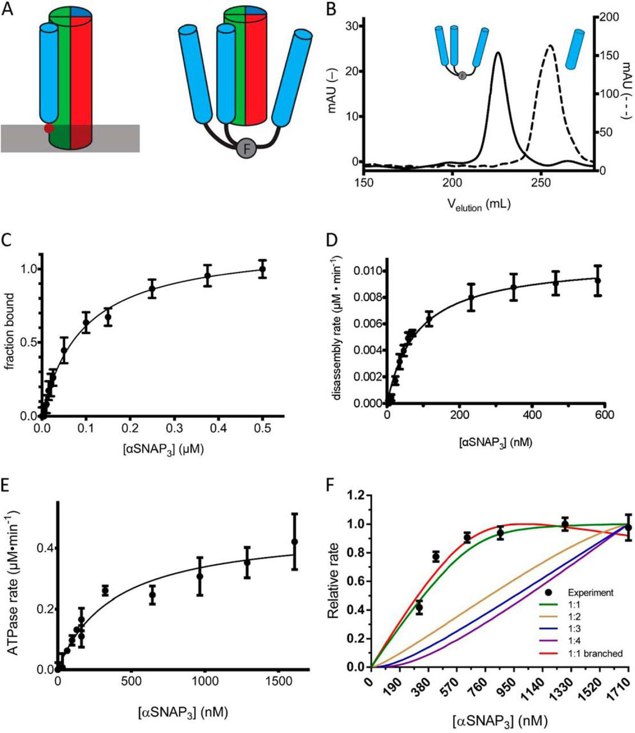
FIGURE 3
Journal of Biological Chemistry 2015 2902175-2188DOI: (10.1074/jbc.M114.620849)
Copyright © 2015 © 2015 ASBMB. Currently published by Elsevier Inc; originally published by American Society for Biochemistry and Molecular Biology. Terms and Conditions
Notes:
An engineered trimeric αSNAP binds to the SNARE complex, activates NSF ATPase, and mediates more efficient disassembly of the SNARE complex. A, schematic model of αSNAP interaction with the SC. The membrane is indicated by a gray bar, and the membrane-interacting loop of αSNAP is indicated by the solid red circle. The T4-foldon trimer is indicated by F. The N-terminal fusion of the trimer to αSNAP may mimic the orientation of αSNAP on the membrane. B, comparison of the A280 signal in milliabsorbance units from size exclusion chromatography (S200) elution profiles of αSNAP3 (solid, left y axis) and αSNAP (dashed, right y axis). C, SC containing labeled VAMP2 (A488; 0.05 μm) was combined with increasing concentrations of αSNAP3 (0–0.5 μm), and the change in fluorescence anisotropy was measured. The data are shown fit to a single-site binding curve giving Kd^{αSNAP·SC} = 100 ± 4 nm. D, initial rates of SC disassembly in steady-state conditions were measured in increasing concentrations of αSNAP3 (0–590 nm). The data are fit to the equation, ν = Vmax/(1 + (Km/[αSNAP])) to give the maximal rate kcat and Km^{αSNAP3} for SC disassembly (solid black line) (Table 2). E, the ATPase activity of NSF was measured as a function of αSNAP3 concentration. The data are fit to the equation, ν = Vmax/(1 + (Km/[αSNAP])) (solid black line) to give Km^{αSNAP3} for NSF ATPase activity. F, SC disassembly rates (y axis) were measured with SC and NSF at fixed concentrations (280 nm) over a range of αSNAP3 concentrations (320–1710 nm). The lines correspond to models with different αSNAP3 stoichiometry, as indicated in the key. The steeper rise for the branched curve as compared with the unbranched curve results from the normalization of the calculated data to the maximum rate. Because the branched curve has a lower absolute maximum rate than the unbranched curve, it reaches its maximum more quickly. Descriptions of the models used can be found under “Experimental Procedures.” Error bars, S.E.

Slide 5
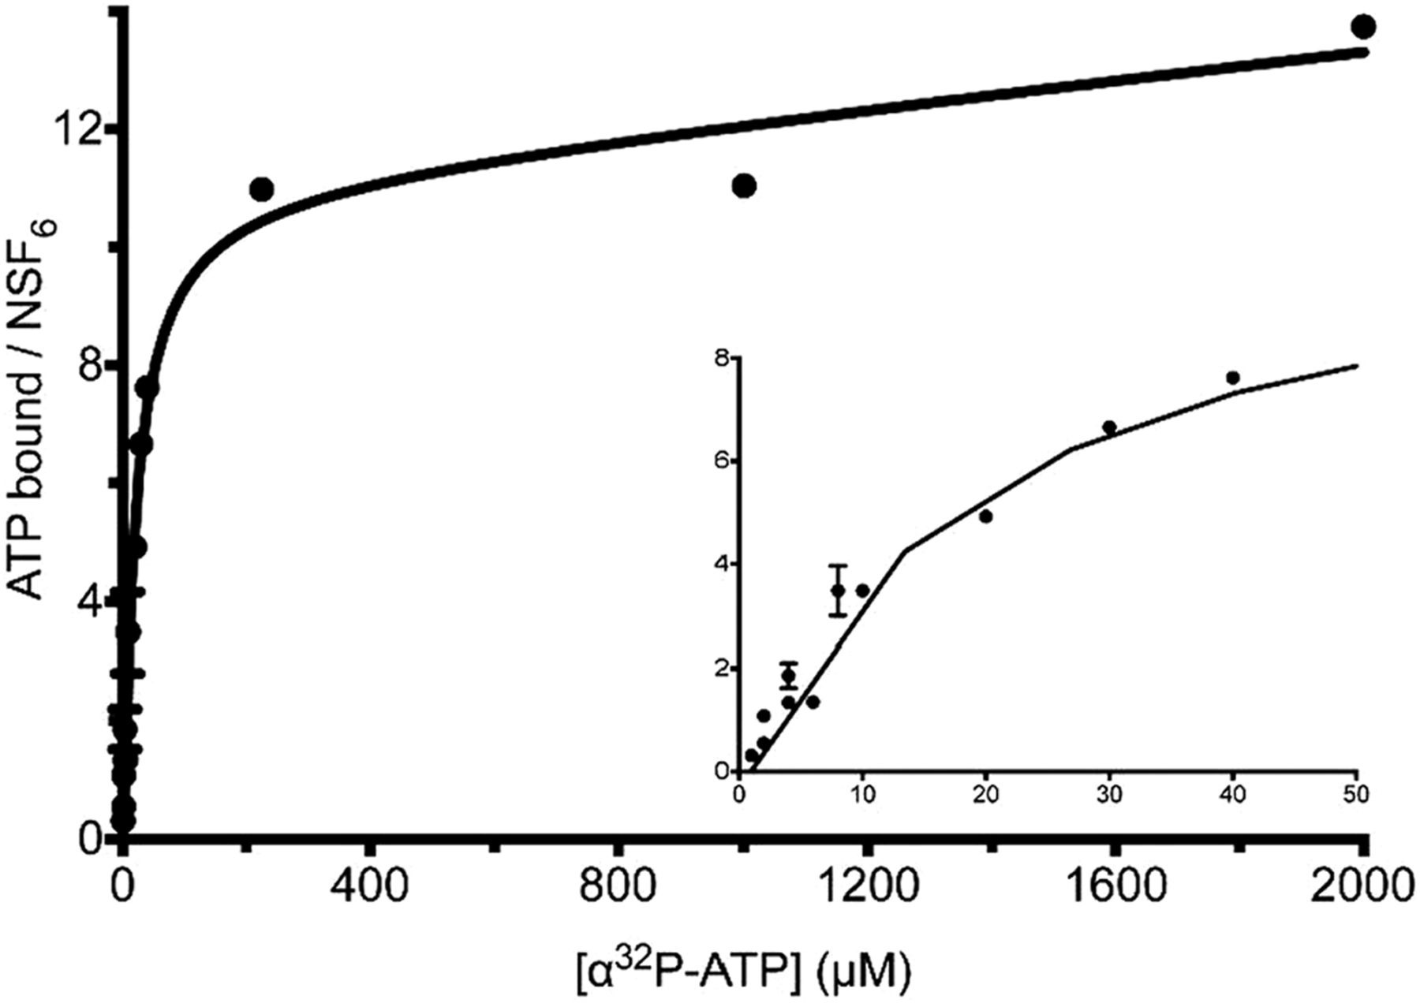
FIGURE 4
Journal of Biological Chemistry 2015 2902175-2188DOI: (10.1074/jbc.M114.620849)
Copyright © 2015 © 2015 ASBMB. Currently published by Elsevier Inc; originally published by American Society for Biochemistry and Molecular Biology. Terms and Conditions
Notes:
The NSF hexamer binds 12 ADP molecules at saturation. Purified NSF (20 nm) was incubated at 30 °C with varying concentrations of [α-³²P]ATP (0.5–2000 μm) in the presence of Mg²⁺, and nucleotide·protein complexes were quantified for protein and nucleotide content. NSF binds 11.5 ± 0.8 molecules of [α-³²P]ATP per hexamer with a Kd of 20 ± 4.8 μm. With [γ-³²P]ATP used in the same binding experiment, no ³²P signal is detected (data not shown), indicating that NSF binds 12 ADP molecules at equilibrium.

Slide 6
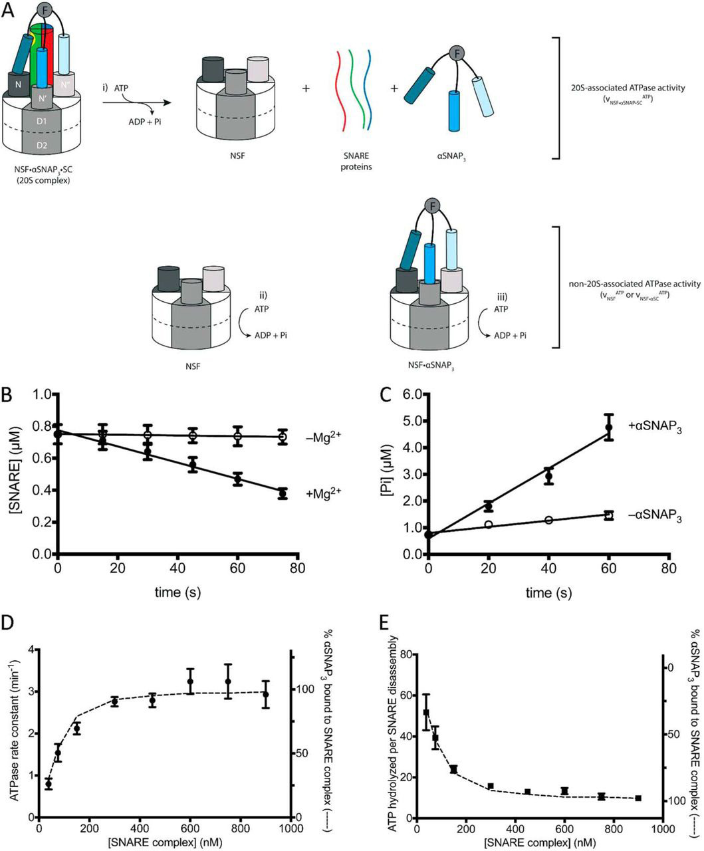
FIGURE 5
Journal of Biological Chemistry 2015 2902175-2188DOI: (10.1074/jbc.M114.620849)
Copyright © 2015 © 2015 ASBMB. Currently published by Elsevier Inc; originally published by American Society for Biochemistry and Molecular Biology. Terms and Conditions
Notes:
Pre-steady-state analysis of NSF ATP hydrolysis and SNARE disassembly. A, NSF hydrolyzes ATP in the NSF·αSNAP·SC (20 S) complex, leading to SC disassembly (i), and outside the 20 S complex (ii and iii). B, SC disassembly in the presence (filled circles) and absence (open circles) of Mg²⁺ (n = 3; error bars show S.E.). C, ATP hydrolysis in the presence (filled circles) and absence (open circles) of αSNAP3. C and D, a representative pre-steady-state experiment ([NSF] = 1.96 μm, [αSNAP3] = 100 nm, [SC] = 750 nm) (n = 3; error bars show S.E.) used to obtain reaction rates. D, pre-steady-state disassembly and ATP hydrolysis experiments were performed at different SC concentrations (38–900 nm), and the rate constant for ATP hydrolysis versus SC concentration is plotted with the full data from Table 4. The percentage of αSNAP3 in the αSNAP3·SC complex in each experiment (dashed line, right y axis) was calculated from experimental protein concentrations and the independently determined dissociation constant of Kd^{αSNAP·SC} = 100 nm (see “Experimental Procedures”) (error bars show propagated uncertainty in the linear regression of ATP hydrolysis and SC disassembly measurements in B and C above). E, the number of ATPs hydrolyzed per SC disassembly are plotted versus SC concentration of each experiment (data points, left y axis). The percentage of αSNAP3·SC fits the data points well (dashed line, right y axis). Error bars, propagated uncertainty in the calculation of ATP per SC.

Slide 7
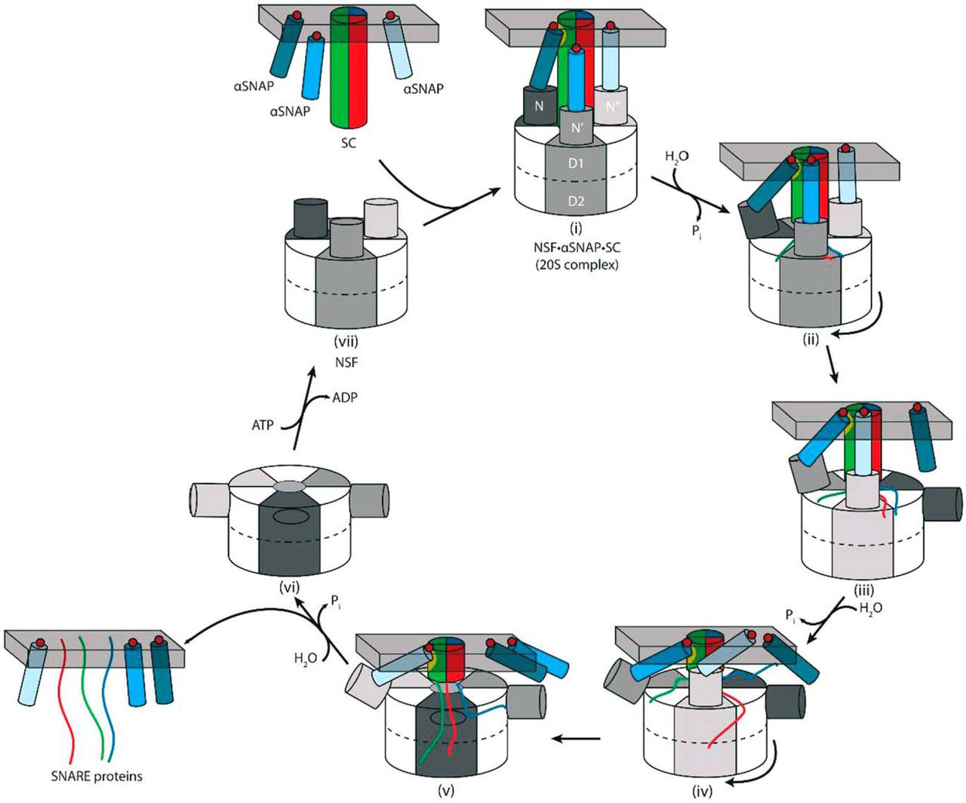
FIGURE 6
Journal of Biological Chemistry 2015 2902175-2188DOI: (10.1074/jbc.M114.620849)
Copyright © 2015 © 2015 ASBMB. Currently published by Elsevier Inc; originally published by American Society for Biochemistry and Molecular Biology. Terms and Conditions
Notes:
Model for SNARE complex disassembly by NSF. αSNAP molecules (blue cylinders) associated with the membrane using hydrophobic loops (red circles) bind the SC (multicolored cylinder) and NSF to form the 20 S complex (i). The primary binding site on the SC for αSNAP is shown as a yellow patch, and the gray bar indicates the membrane. Outward and downward movement of the N-domains upon ATP hydrolysis (power stroke) may release αSNAP transiently (ii), and rotation of the NSF hexamer positions a different αSNAP at the primary binding site (iii). ATP hydrolysis and rotation steps are repeated (iv and v), and disassembled SNARE proteins and αSNAP remain membrane-associated (vi). Displacement of ADP for ATP resets the N-domains into an “up” conformation, where a new αSNAP·SC complex can be disassembled (vii). If αSNAP were always bound to both the NSF N-domain and to the SC, then as the SC is unwound and NSF translocates, the NSF N-domain would tilt more and more with respect to the SC, shortening the lever arm and potentially reducing the force that can be applied to the complex. See “Discussion” for details.

Slide 8
(Eq. 3)
Journal of Biological Chemistry 2015 2902175-2188DOI: (10.1074/jbc.M114.620849)
Copyright © 2015 © 2015 ASBMB. Currently published by Elsevier Inc; originally published by American Society for Biochemistry and Molecular Biology. Terms and Conditions

